Slide 1
Natural Langauge Generation

Slide 2
Content Determination
Different communicative goal
Content
Constraints
Information Source

Slide 3
Sentence planning
Discourse Analysis e.g. Temp content then rainfall content.

Slide 4
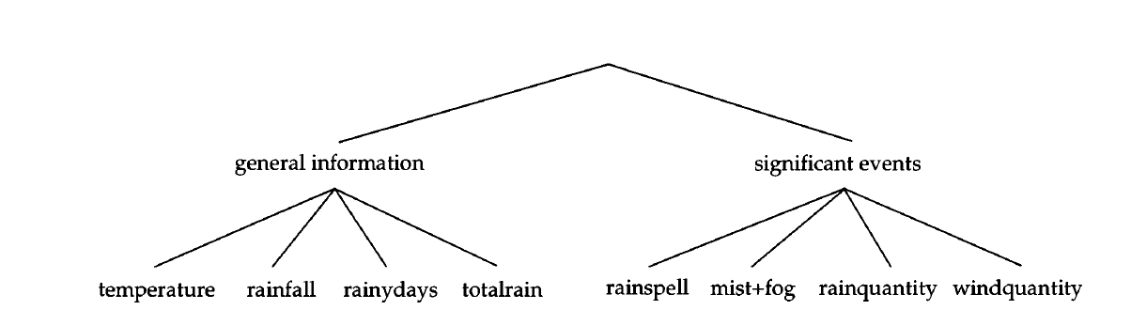
Example

Slide 5
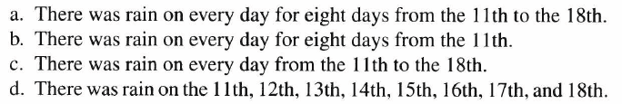
Lexicalisation
It is about selecting correct words- Nouns, Verbs, Phrases.

Slide 6
Reference Expression Generation
For example, March 1995
  March

Slide 7
NLG Architecture
Document planning
Micro-planning
Surface realization

Slide 8
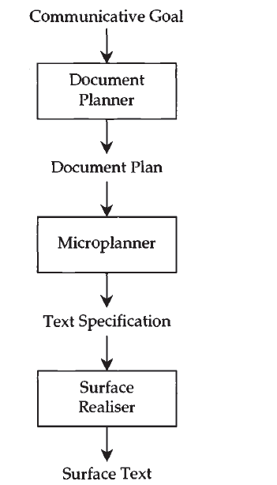
Workflow

Slide 9
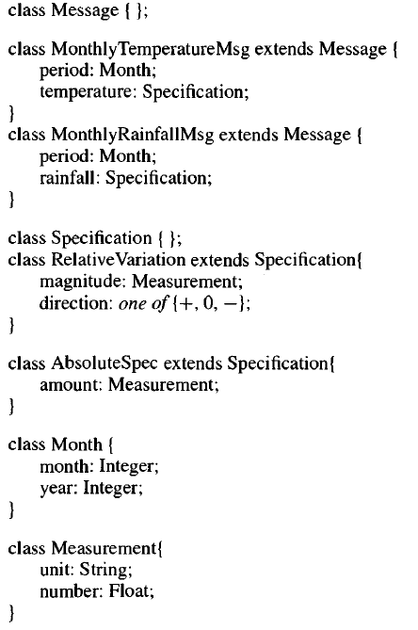

Slide 10
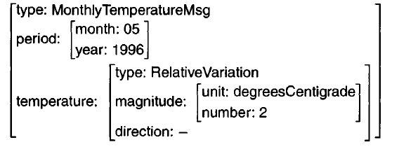

Slide 11
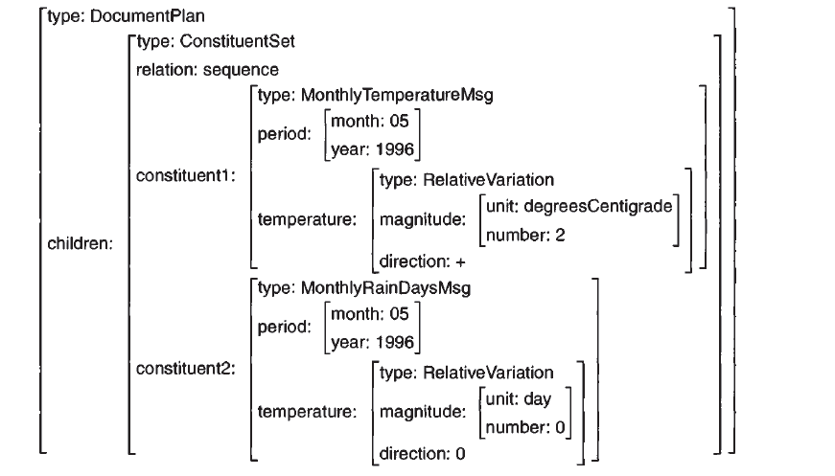
Document Plan

Slide 12
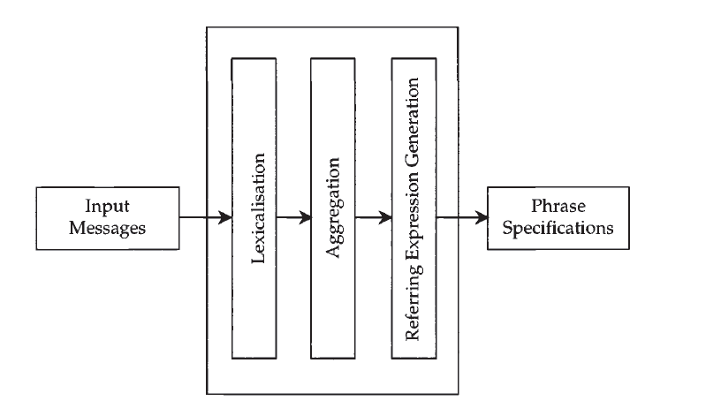

Slide 13
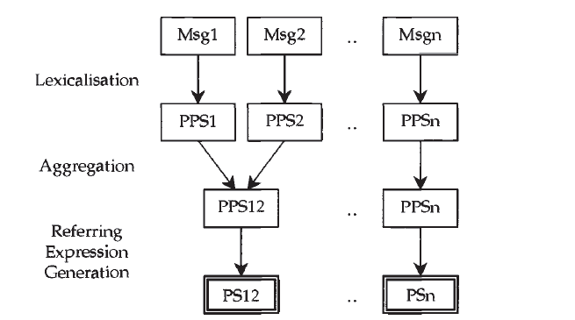

Slide 14
Surface Realization
Skeleton prepositions
Meaning specifications
Lexicalized case frames
Abstract syntactic structure
Canned text

Slide 15
Meaning specification

Slide 16
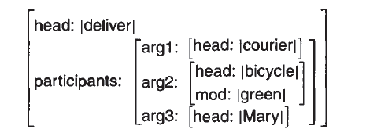
Lexicalised case frames

Slide 17
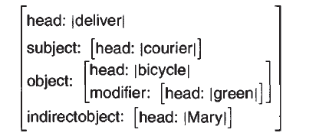
Abstract syntactic structure

Slide 18

Canned text

